Slide 1
Salary Prediction Analysis A Machine Learning Analysis of Census Data
sarabjit kaur matharu
data science flex, lighthouse labs

Slide 2
Motivation
Studying Census data allows economists to grasp the driving forces behind Income.
This information makes it possible to plan better services, improve the quality of life and solve existing problems.
Statistical information, which serves as the basis for constructing planning forecasts, is essential for the democratic process.

Slide 3
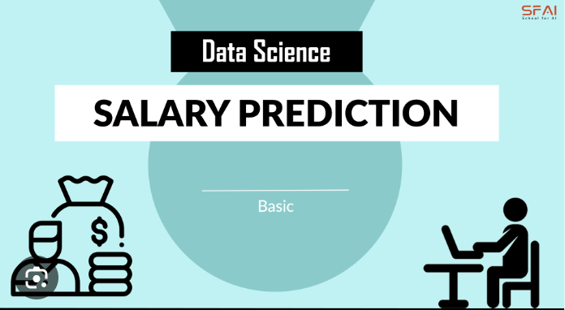
BASIC Process
OBTAIN DATABASE
DATA CLEANING & EDA
MODELING
ANALYSIS

Slide 4
OBJECTIVE
I got this data set from Kaggle.
Extraction was done by Barry Becker from the 1994 Census database. A set of reasonably clean records was extracted exploring demographic information.
In this project , I did classification – >50k or <50k

Slide 5
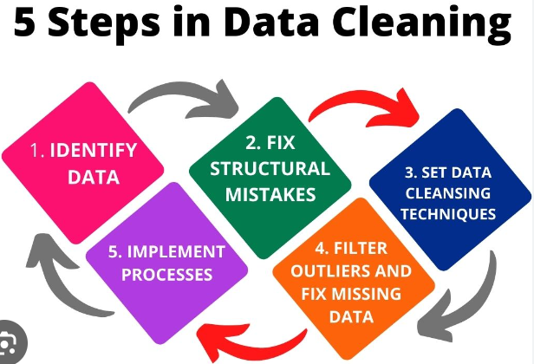
DATA CLEANING
Dealing with missing data & N/As.
Attributes workclass and occupation have most NAs. I cleaned database &B removed those N/A’s

Slide 6
attributes from dataset
age
Workclass
fnlwgt:This is the number of people the census believes the entry represents.
education
education­num: the highest level of education achieved in numerical form.
marital­status
occupation
relationship
Race
Sex
hours­per­week
predclass : whether or not an individual makes more than $50,000 annually.

Slide 7
PredClass
Income level less than 50K is more than 3 times of those above 50K.
Analysis result can change if we study different database and time zone. The original dataset contains a distribution of 23.93% entries labeled with >50k and 76.07% entries labeled with <=50k.

Slide 8
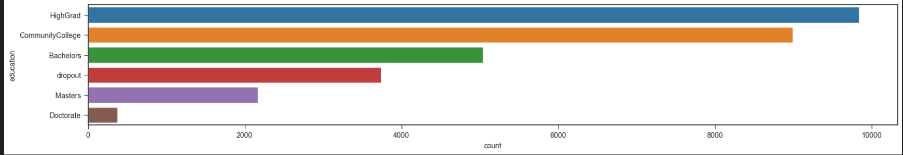
EDUCATION ANALYSIS
This graph shows a really good education analysis clearly showing with the help of a bar graph. Some education categories are combined for clear analysis.

Slide 9
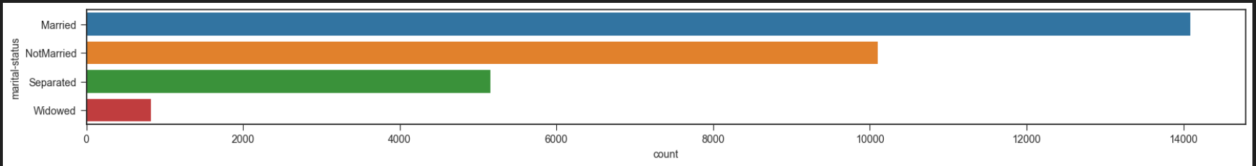
Marital status analysis
For this attribute values are re-categorized to make easy classification. E.g. Divorced & Separated are both
labelled as Separated.

Slide 10
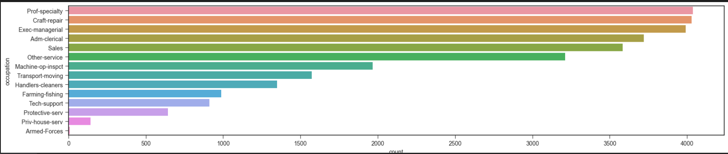
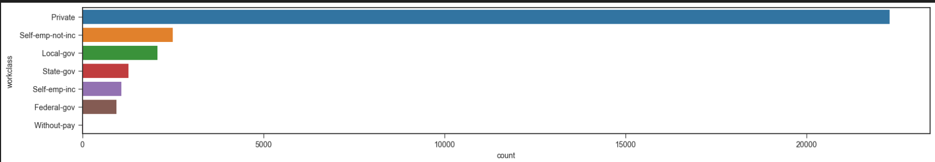
Occupation analysis
WORKCLASS ANALYSIS

Slide 11
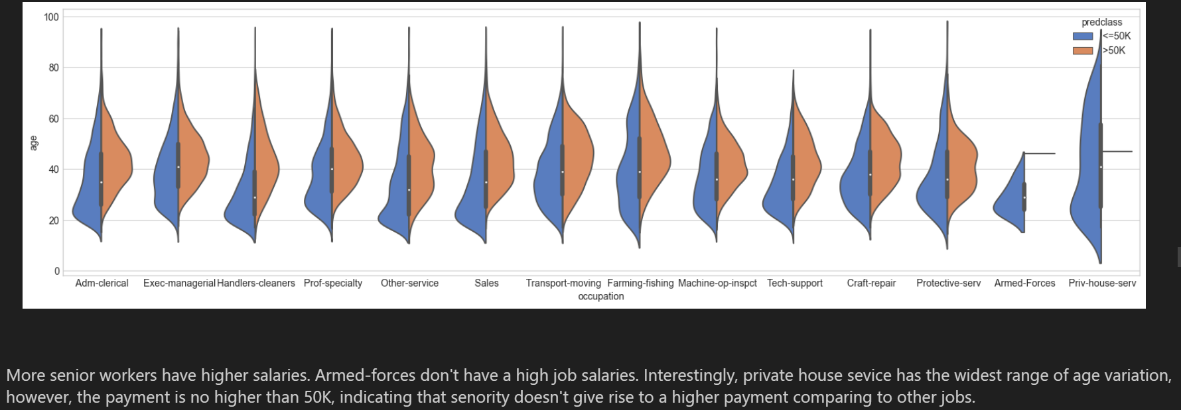
Relationship between age, occupation & predclass
We can see trend with database. More senior workers have higher salaries. Private house service has the widest range of age variation.

Slide 12
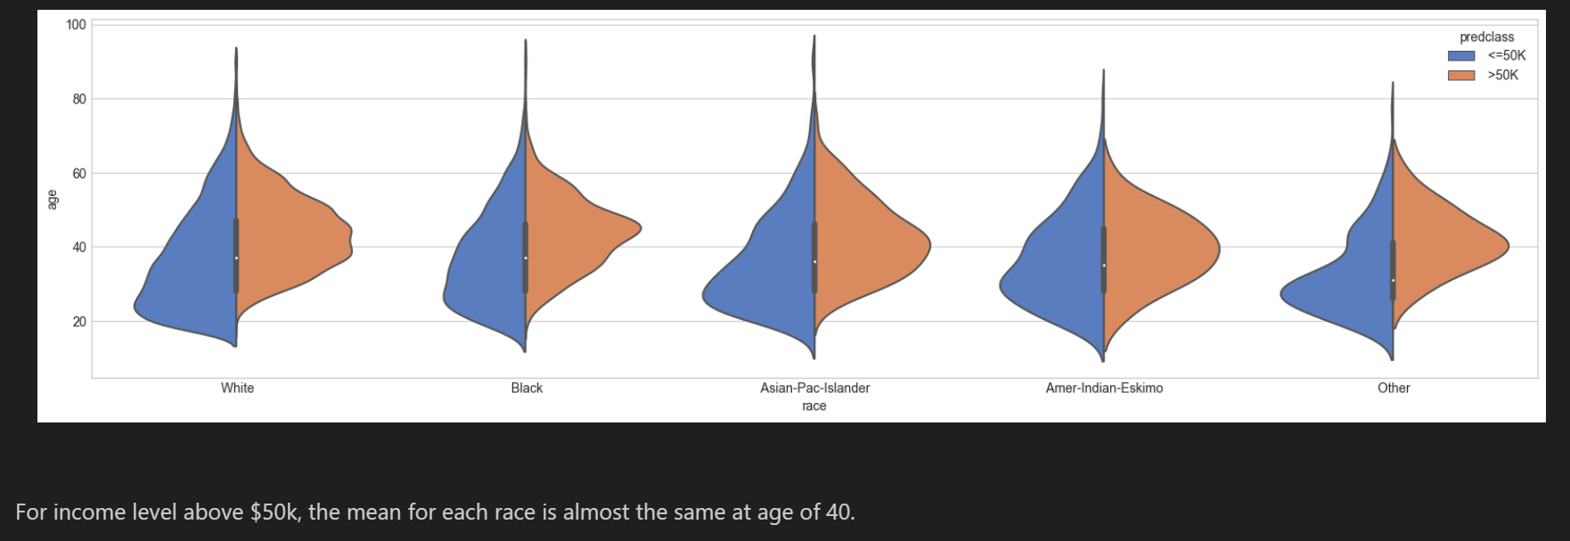

Slide 13
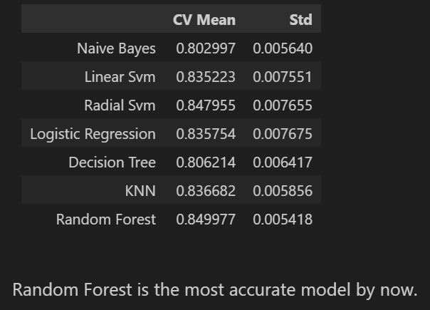
Comparison of Models

Slide 14
Reflection
Education data was dropped as it was collinear with education number.
Marital - Status Categories were clubbed into single related category.
Interestingly chances of having salary greater than 50k is high.
Most people are working 40 hours a week. But among those who work more than 40 hours a week, the proportion of people having >50k is high.
Married people have more chances of having income >50k as compared to never married and divorced.

Slide 15
Reflection
More people working in private sector are making less than 50k.
Income is more for higher age group.
Higher value of education number maximizes the chance of income >50k.
The highest chances of having income >50k are in : Prof-School, Doctorate, Masters, Bachelors & Assoc-Voc.

Slide 16
Looking forward
Hyperparameter tuning
More feature Engineering
Use of Regression Model

Slide 17
Thank You
Sarabjit Kaur Matharu

